Slide 1
Directed acyclic word graph for word correction and string auto completion
By: Terrence Gausi, Christian Lopez, Hango Gu

Slide 2
Ternary tree Insertion
We will use the current input as an example throughout our presentation: BREAD
HEAD MEAD
READ

Slide 3

Ternary tree Rotation
YOINK!

Slide 5
Compression to directed acyclic graph

Slide 6
Cycles!

Slide 7
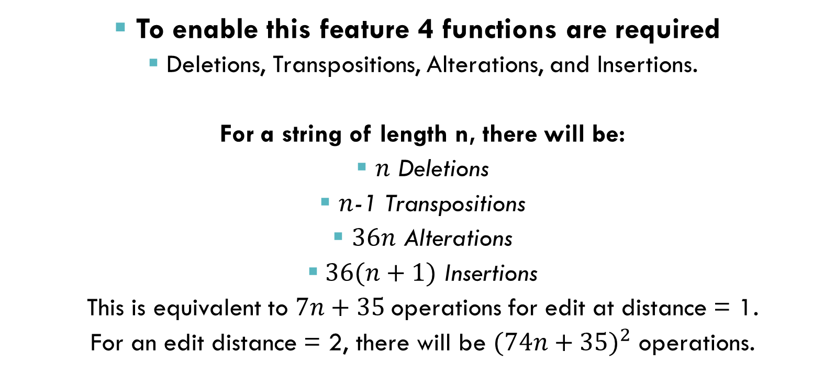
Word correction & string auto complete
To enable this feature 4 functions are required
Deletions, Transpositions, Alterations, and Insertions.
For a string of length n, there will be:
$n$ Deletions
$n$-1 Transpositions
$36n$ Alterations
$36(n+1)$ Insertions
This is equivalent to $7n+35$operations for edit at distance = 1.
For an edit distance = 2, there will be ${(74n+35)}^{2}$ operations.

Slide 8
Other applications
Finding IP addresses
Finding street addresses
Compressing data with repetitions and similar strings
Not limited to an English dictionary
Works for any string

Slide 9
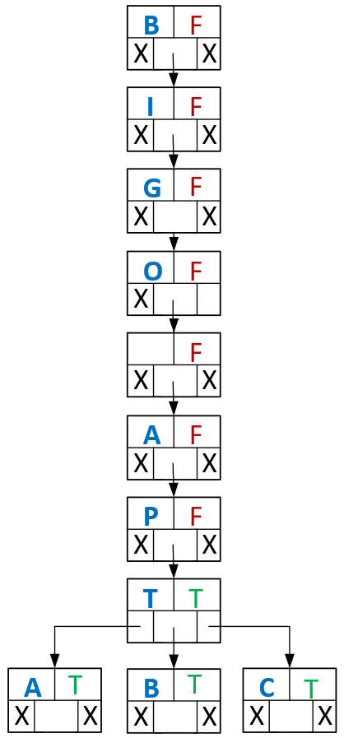
Image your friend lives in BigO Apt C, but you thought that he lives in BigO Apt D. When you search the address in your navigator,you will encounter this response.
“ Whoops, looks like BigO Apt D does not exist. Did you mean: >>BigO Apt A
>>BigO Apt B
>>BigO Apt C ”

